Slide 1
DNN for Concrete Strength prediction

Slide 2
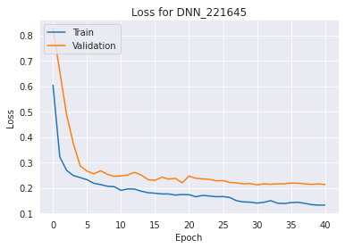
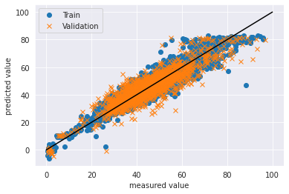
DNN
Batch Size: 128
# of Layers: 5
# of Node: 64
cv_r2: 0.7954
cv_mse: 28.88
cv_rmse: 5.37
train_r2: 0.8865
train_mse: 15.30
train_rmse: 3.911

Slide 3
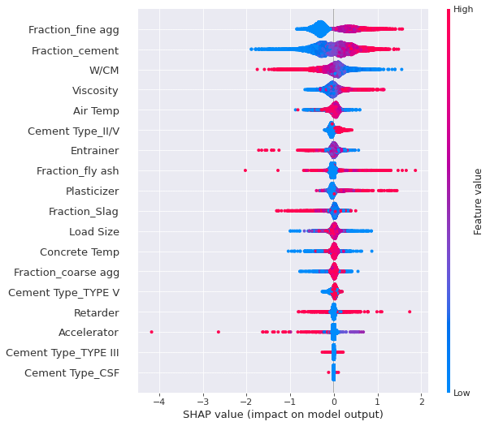
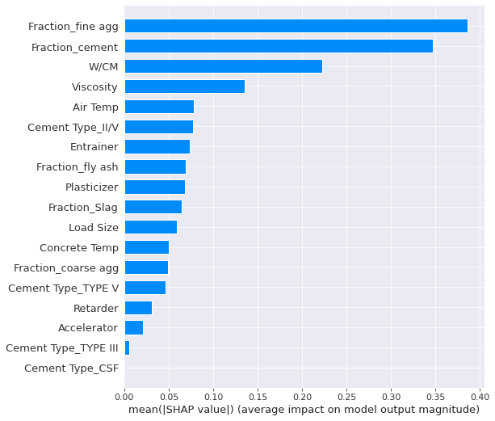
Shap Summary Plot

Slide 4
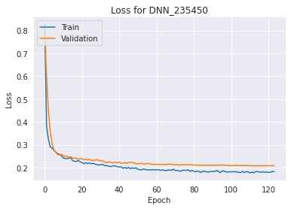
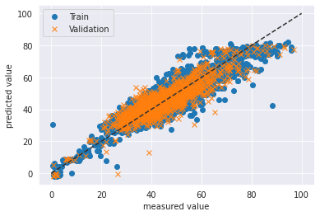
DNN
Batch Size: 128
# of Layers: 4
# of Neurons: 32, 32, 16 , 8
cv_r2: 0.7899
cv_mse: 28.40
cv_rmse: 5.33
train_r2:0.8423
train_mse: 21.56
train_rmse: 4.64

Slide 5
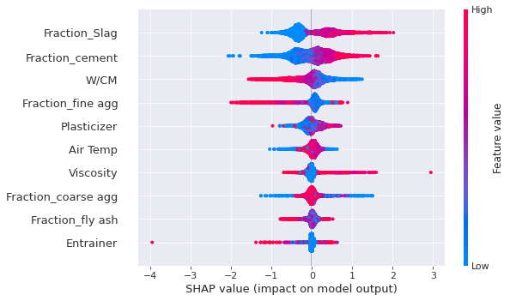
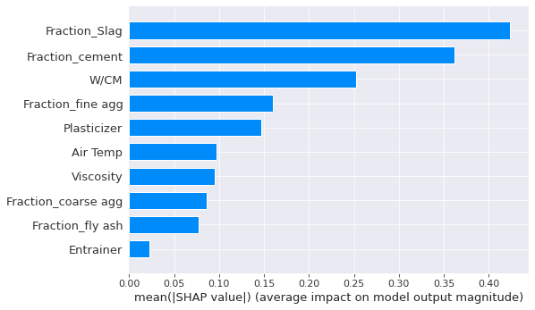
Shap Summary Plot

Slide 6
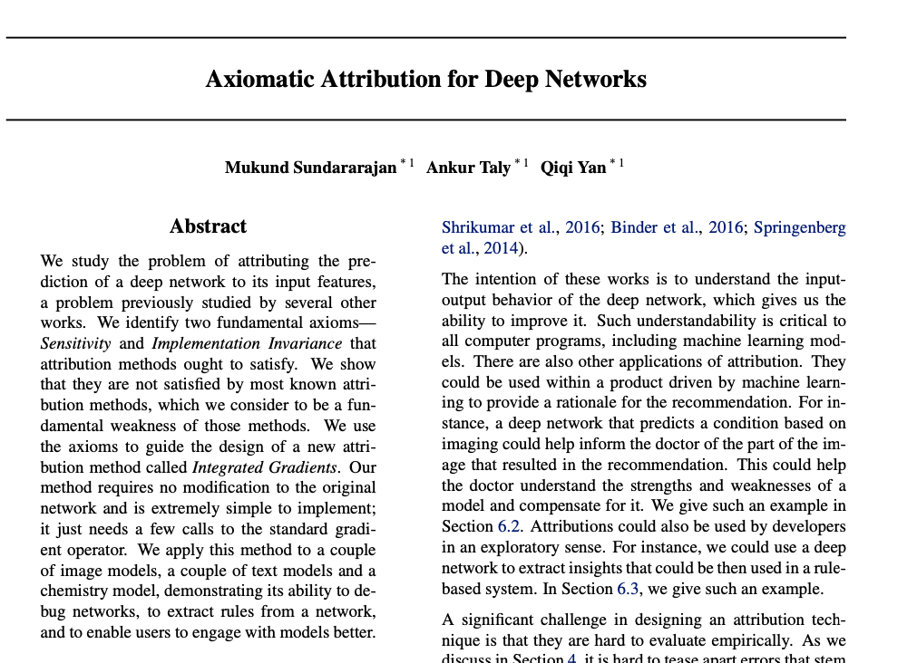
arXiv:1703.01365

Slide 7
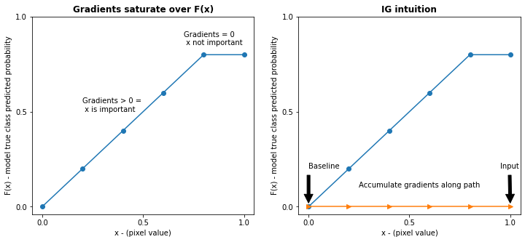
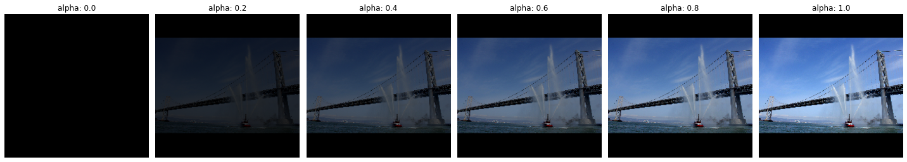
Integrated Gradients

Slide 8
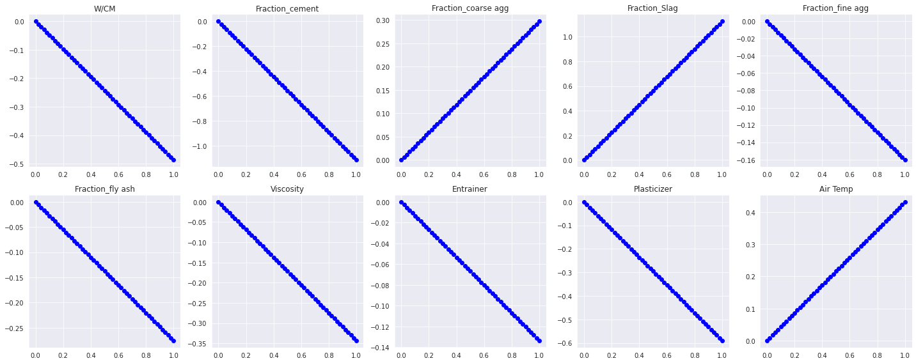
Interpolated Data

Slide 9
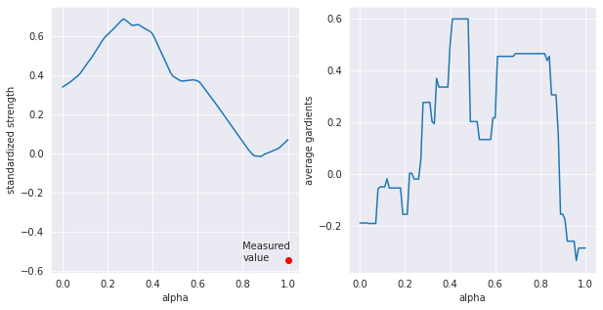
Gradients as Alpha increased
Data index: 4251

Slide 10
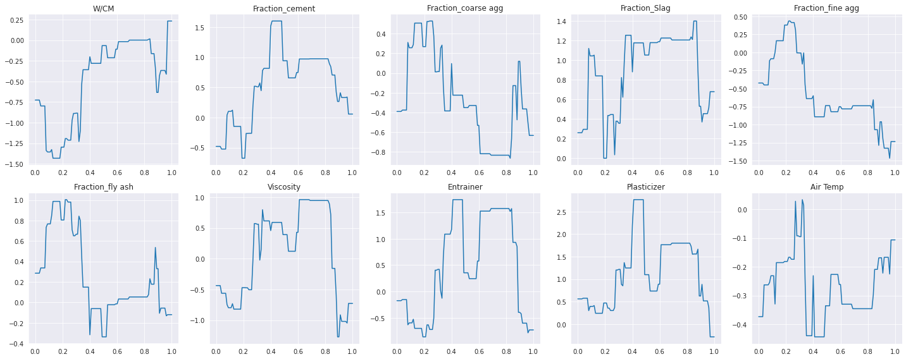

Slide 11
Gradients
Data index: 4251

Slide 12
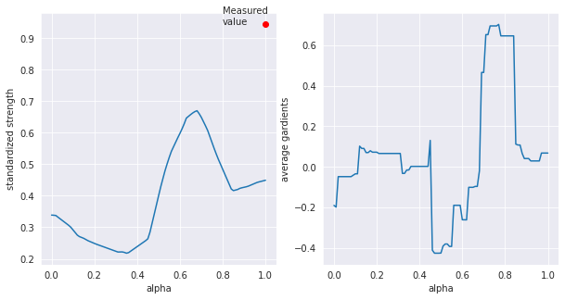
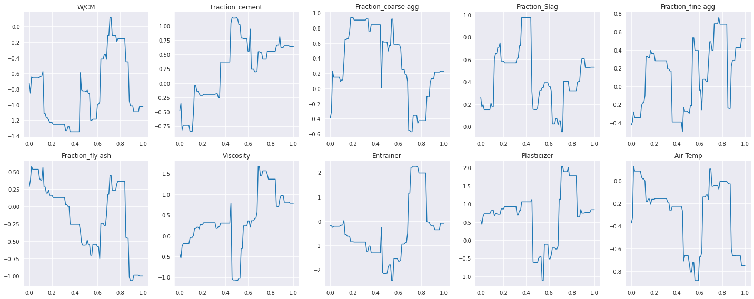
Gradients
Data index: 7250

Slide 13
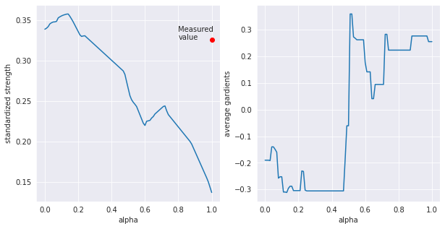
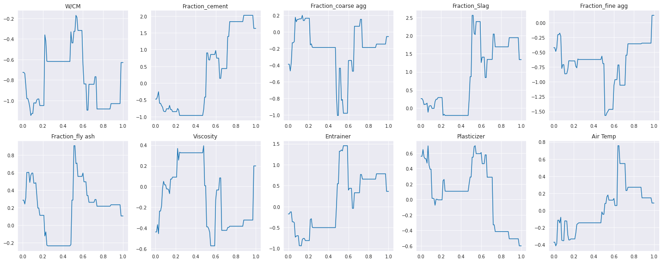
Gradients
Data index: 2121

Slide 14
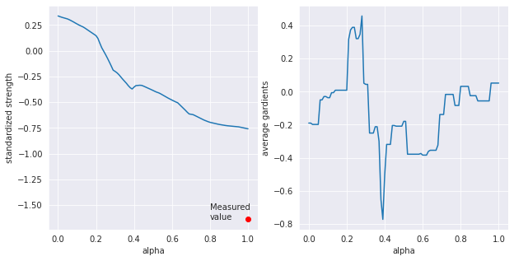
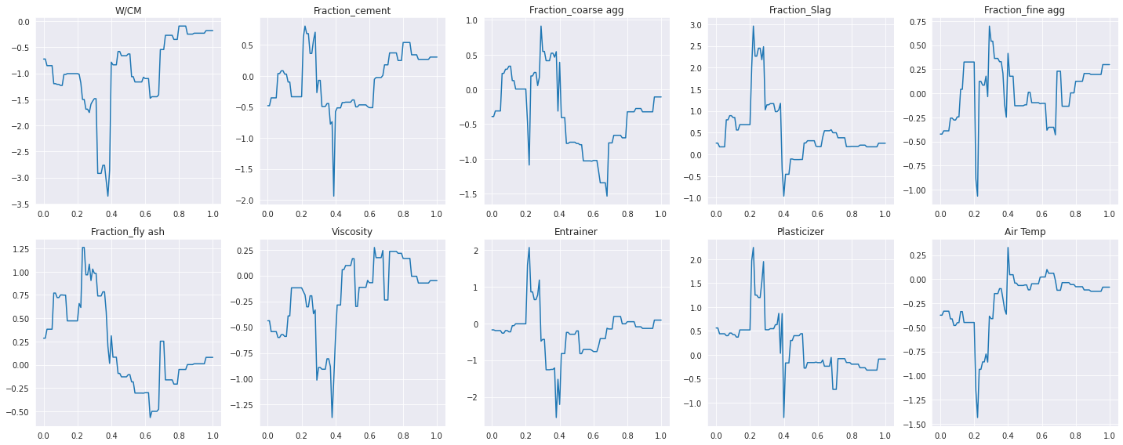
Gradients
Data index: 8370

Slide 15
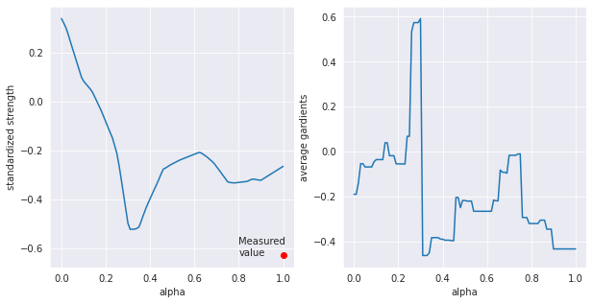
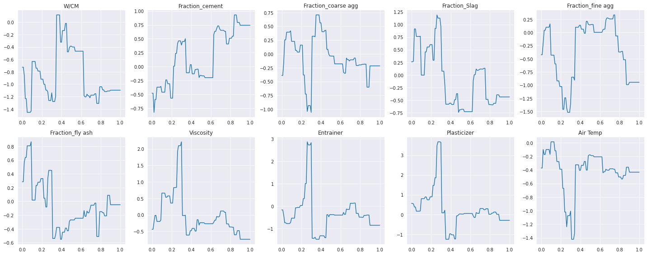
Gradients
Data index: 3303

Slide 16
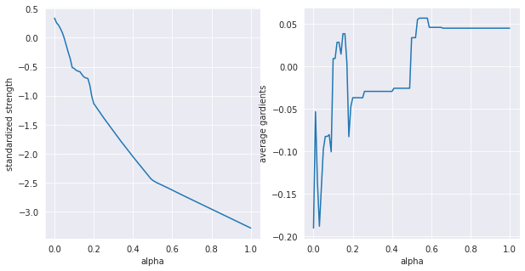
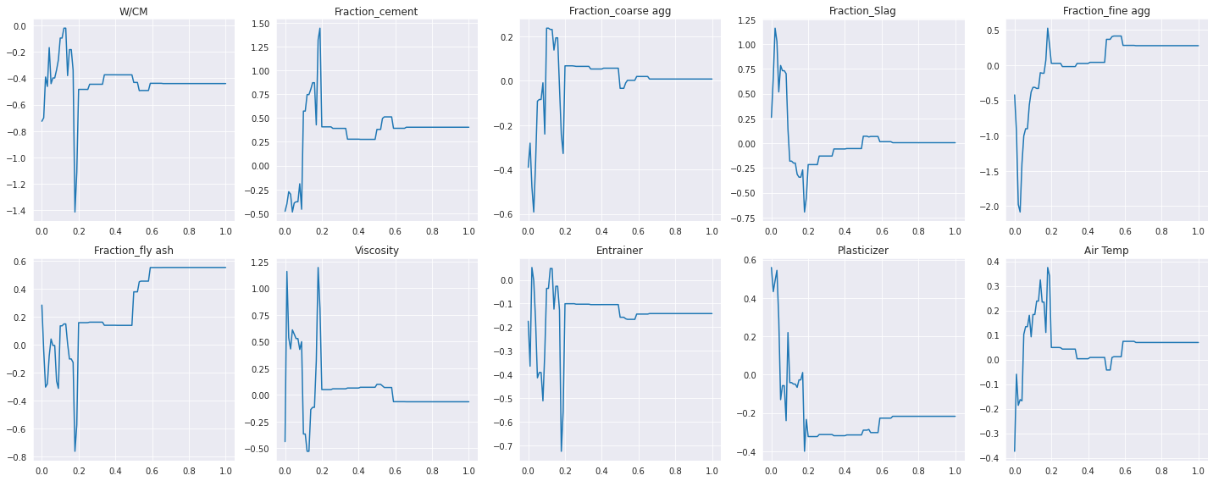
Pseudo data

Slide 17
